Slide 1


SMART INDIA HACKATHON 2026
Problem Statement ID – 26118
Problem Statement Title- Passive Colorimetric H2S Exposure-Dosimeter Wristband with AI-Based Quantitative Reading
Theme- Smart Automation
PS Category- Hardware
Team ID-
Quantum Realm

Slide 2


Quantum Realm

Slide 3


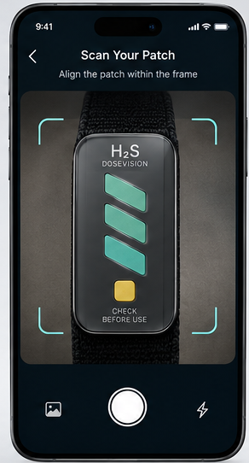
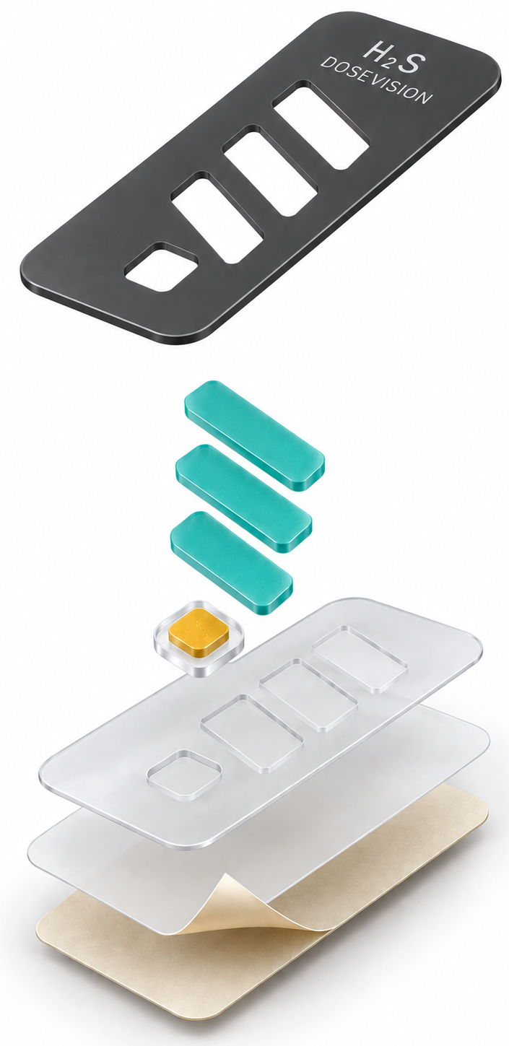
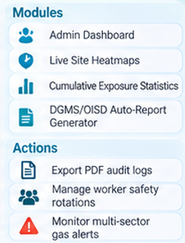
Quantum Realm

Slide 4
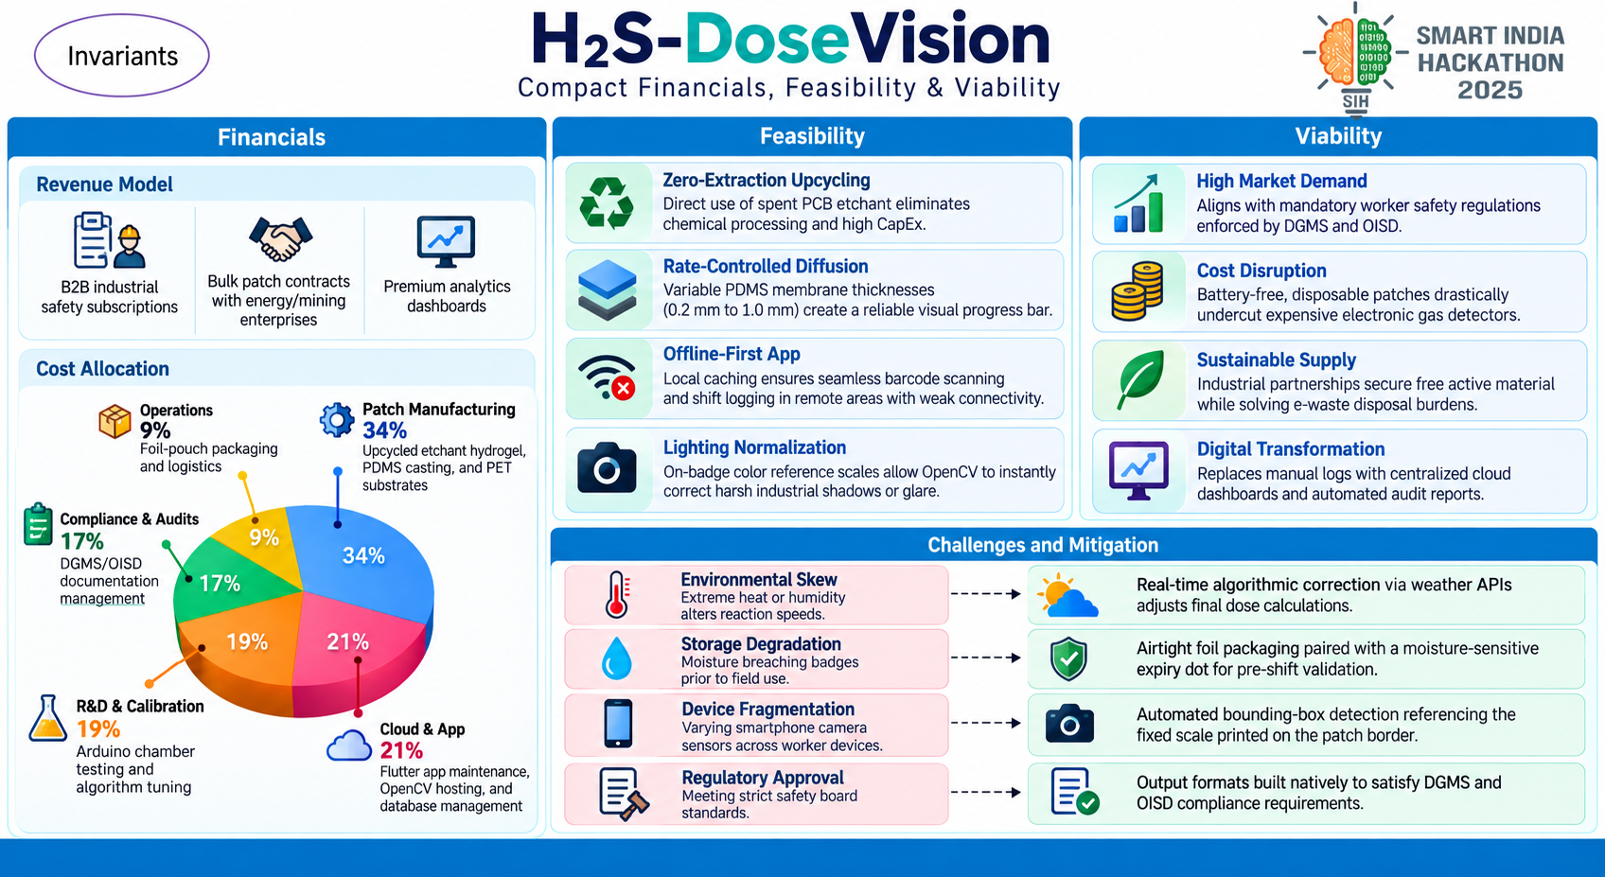
Quantum Realm

Slide 5


Slide 6
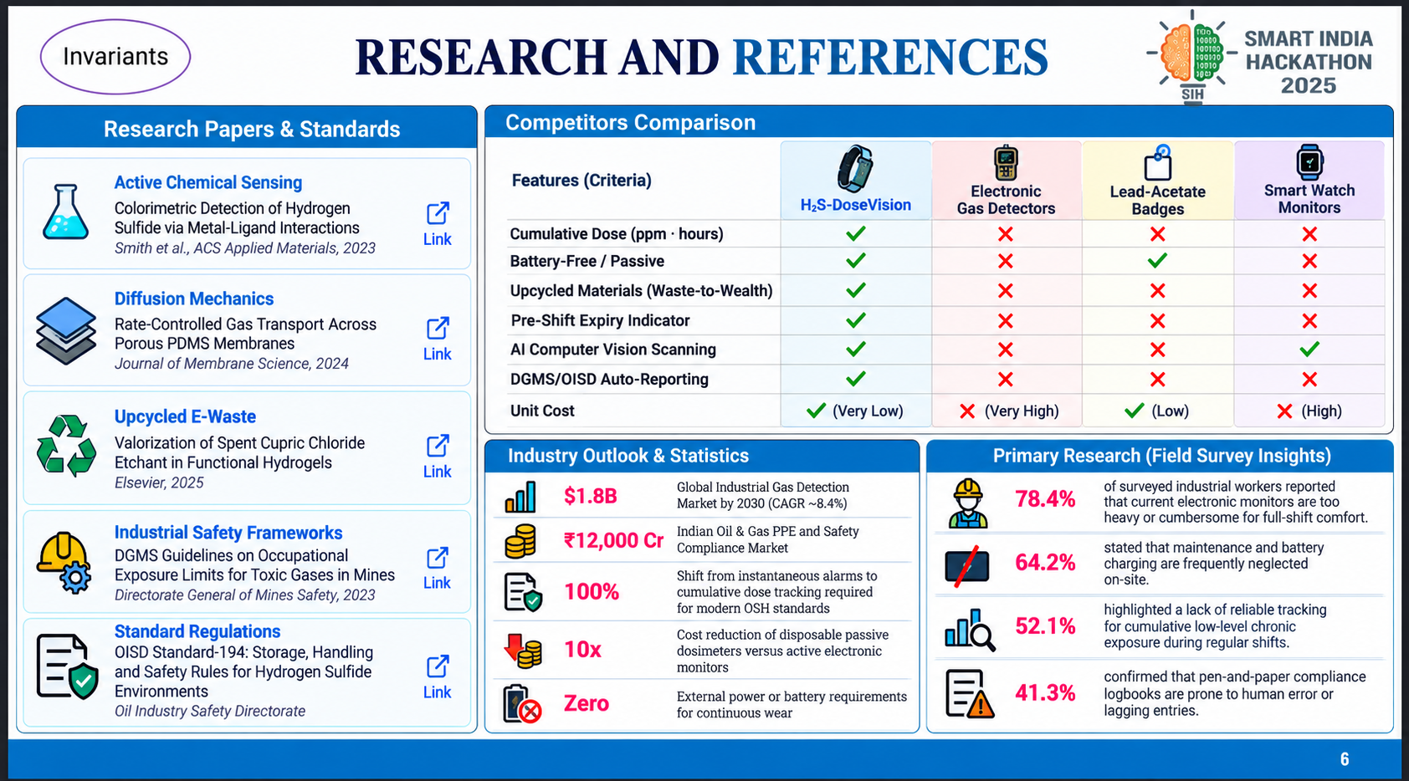
Quantum Realm

